Slide 1

Design Manual CTU Care App

Slide 2

Splash Screen

Slide 3
Introduction
As mentioned later in the technical manual, there application is quite large and the likelihood of achieving everything set out in this manual is unlikely due to limitations of my programming knowledge and the language itself.
This does not remove the need to have a well constructed plan in any way whatsoever, it just means it is highly likely that the programme will evolve from this plan

Slide 4
Splash Screen
Plan to link the loading bar to the application and once it has loaded the splashscreen will proceed to the next window
This must be done last only if there is time
If you run out of time recycle the timer you have in your calculator app that will just leave the splashscreen up for 5 seconds
Use MainWindow for the SplashScreen

Slide 5
Login Screen
Login
User Name
Password
Login
Add User

Slide 6
Add User Screen
New User
User Name
Password
User
Admin
Admin Password
Add User

Slide 7
Add User Screen
Admin Password box is only visible when admin radio is selected

Slide 8
Home Screen
Home Screen
Filing (Patient Search)
Accounts
Appointments
History

Slide 9
Search Patient Screen
Patients
Search
Search By
Name
Surname
ID Number
Medical Aid Number
File Number
Name
View History

Slide 10
Patient Result Screen
Results
Results
View Statements

Slide 11
Patient Screen
I can always load a view from SQL for the datagrid if I’m struggling

Slide 12
Accounts Screen
Patients
Search
Search By
Name
Surname
ID Number
Medical Aid Number
File Number
Name
Load Statement

Slide 13
Account Statement Screen
Patients
Statement for
PDF Statements loaded into scrollviewer here
Date 1
Date 2
Date 3
Load
Print
Mail

Slide 14
Statement Screen
It doesn’t have to be able to print, you just have to show the user what is in their account
http://stackoverflow.com/questions/123947/wpf-to-pdf

Slide 15
Home Screen
Home Screen

Slide 16
Home Screen
I want the buttons to always take up a quarter of the window size
Lock the buttons to their own lines in the GUI

Slide 17
Accounts Screen
Creating printable PDFs
https://msdn.microsoft.com/en-us/library/aa970909.aspx flow document

Slide 18
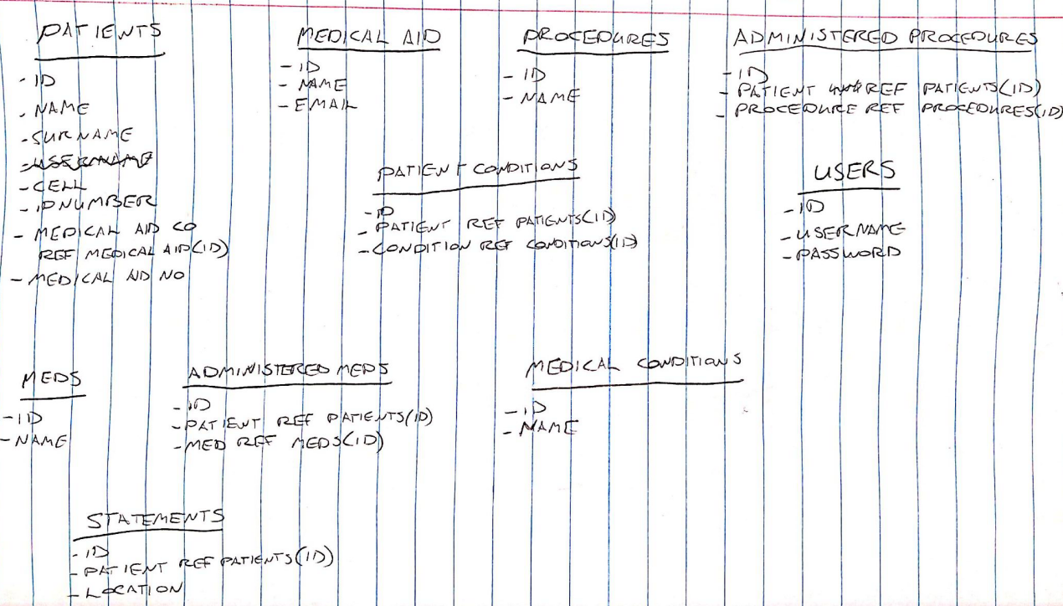
Database
Appointments
When saving appointments to the database, a current appointments table as well as appointments table must get the new appointment saved to it. When closing the appointments it must be deleted from current appointments
Doctors
- ID
- Name
Current Appointments - ID
- Patient Ref Patients(ID)

Slide 19
Storage of Information
Statements must be generated and written to a PDF. The PDF will be saved to a specific location and the location will be stored in the Database
Going to need to have a screen where patient info is displayed.
There needs to be a dispatched button at some point
When this button is clicked, the medical aid needs to be mailed with the statement and the Boolean value needs to be updated in the database
The date entered will be captured when an appointment is made
Use date picker

Slide 20
Recording Appointment Info
When on the appointment screen, there must be a button to book a new appointment
This is where you will be taken to another window
When one wants to book an appointment, there must be a dropdown for patients and an option to add patients if they are not there yet
There will also be a datepicker to select the day you want the patient to come in

Slide 21
Screen

Slide 22
Appointment Screen
Appointment Screen
New Appointment
Past Appointments
Close Appointment

Slide 23
New Appointment Screen
Appointment Screen
Select a Patient
Select a Dr
Planned Procedure
John Smith
Dr Vlok
Lung Transplant
Date to come in
Date scheduled for dispatch
September
13
2011
September
13
2011
New Patient
New Procedure
New Doctor

Slide 24
New Appointment Screen
The time out datepicker will be disabled should the procedure type be consultation

Slide 25
New Doctor Screen
New Doctor
Name
…
Consultation Fee
…
Add

Slide 26
New Procedure Screen
New Procedure
Procedure
…
Price
…
Add

Slide 27
New Patient Screen
New Patient
Name
Cell No
Surname
ID No
Cell No
Medical Aid Co
Text
Medical Aid No
Address
Add

Slide 28
New Patient Screen
The file number for the patient will be added automatically as the ID in the database

Slide 29
Conclusion
Many aspects were changed and integrated, such as patient information, the filing system and the accounts system being refined into one aspect.
I unfortunately ran out of time for aspects such as the printing and emailing of statements as well as syncing the splash screen with the loading of the window.
Through careful database manipulation, I managed to get a similar sort of design and idea to what I had originally set out to do in this document. I was happy with the overall outcome

